Slide 1


Team 22: Solar Home Lighting
Bi-Weekly Update 4 Jack Holdridge
Kyle Walcher
Matthew Greer Sponsor: Guanhua Tao TA: Won Jang
Notes:
Michelle

Slide 2
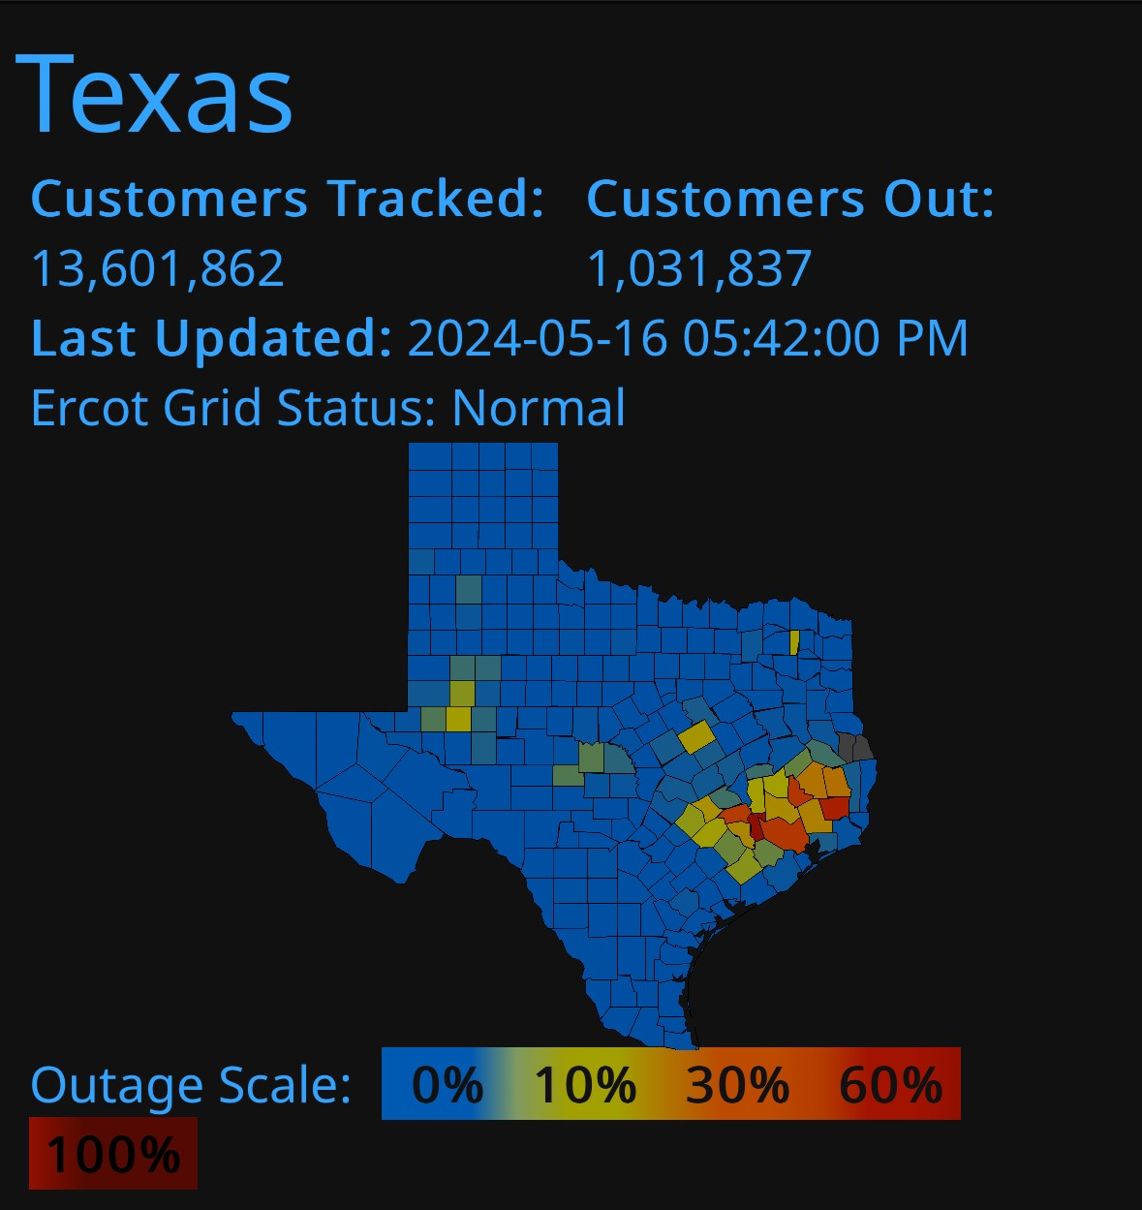
Project Summary
Problem statement:
Current smart-home systems depend on grid power and cloud connectivity, causing lighting and monitoring to fail during outages and creating reliability and usability barriers for users.
Our Solution:
Combine security, lighting control, and user interaction into one coordinated platform
Offer flexible controls, with both local and remote capabilities.
Ensures the home remains safely lit and monitored regardless of grid fluctuations.
Notes:
Kyle

Slide 3
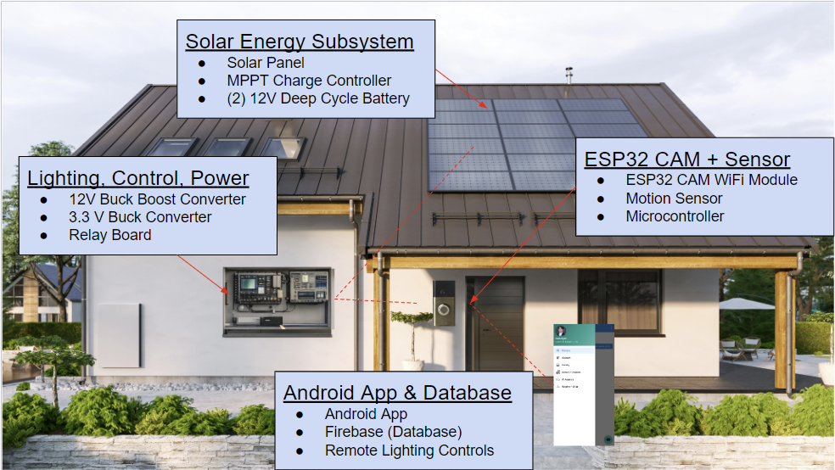
Integrated System Diagram
Notes:
Eric

Slide 4
Project Timeline
Subsystem Designs updated and ready for integration (to complete 2/4/26) | Integration of Database with application (completed 1/28/26) | Integration of motion controls with android application (complete 2/18/26) | Final Integration (to complete 3/4/26) | System Test (to complete 3/18/26) | Validation of system (to complete 3/25/26) | Demo (to complete 4/15/26)
Notes:
Eric

Slide 5
MPPT Charge Controller Adam Garcia
Accomplishments since last update 12 hrs of effort | Ongoing progress/problems and plans until the next presentation
Tested MPPT IC DC Electronic Load CC Mode: Current not limiting to set 8.3A | Finish testing components

Slide 6
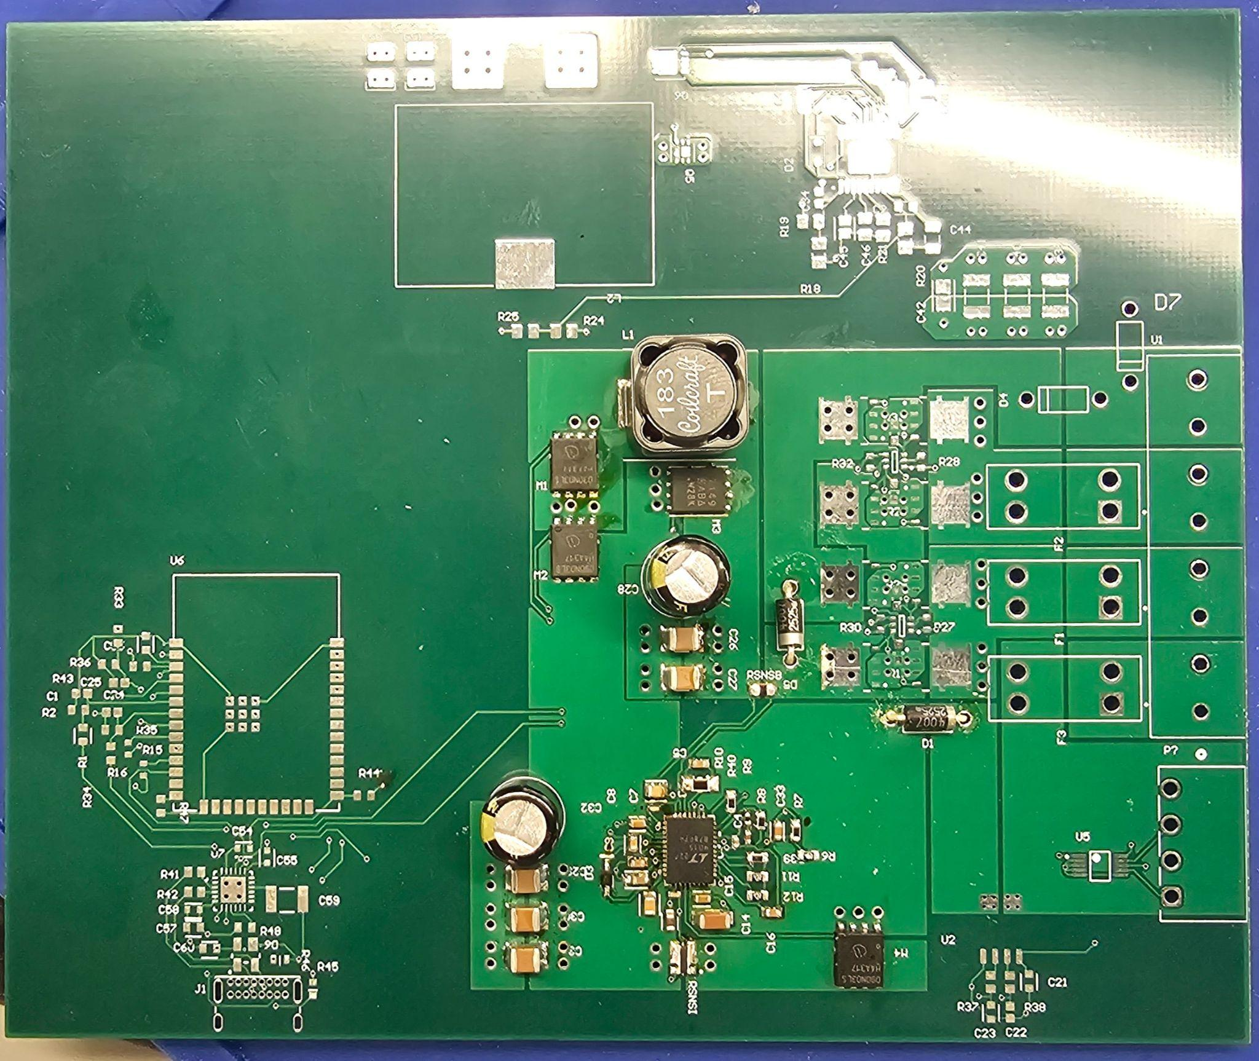
MPPT Charge Controller Adam Garcia
Testing:
MPPT IC soldered onto board
Tested buck conversion with DC Electronic Load.
RSNSB set to limit current to 8.33A

Slide 7
Physical Controls Jack Holdridge
Accomplishments since last update 22 hrs of effort | Ongoing progress/problems and plans until the next presentation
Verified bidirectional communication between HMI touchscreen and MCU controller, through local and remote toggles. Confirmed remote state updates propagate to the HMI display. Tested lighting control hardware integration. Added pull up wire circuit to send security camera trigger. | Completed 3D CAD model for the system housing; initial 3D print failed and adjustment are being made. Firmware refinement and communication testing to prepare for complete MCU code upload. Installing motion and LDR sensors, and verifying stability.

Slide 8
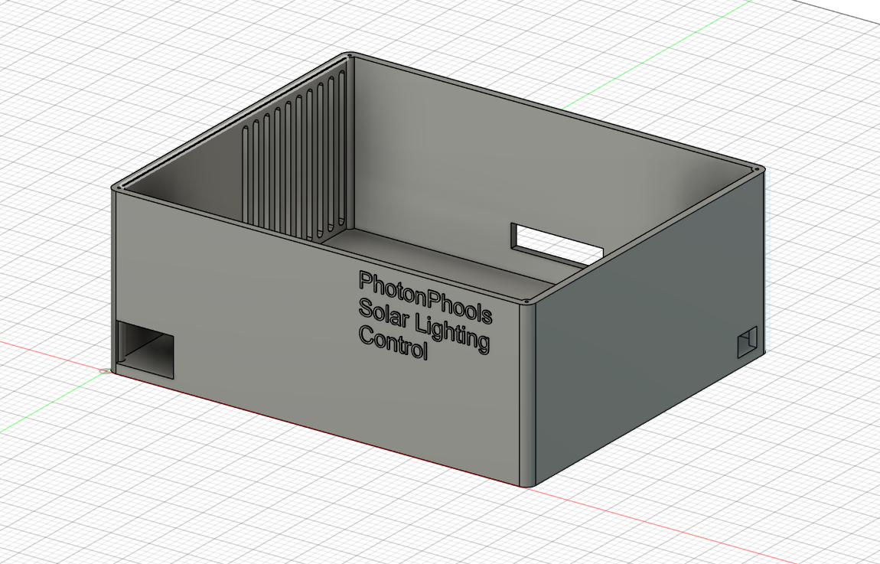
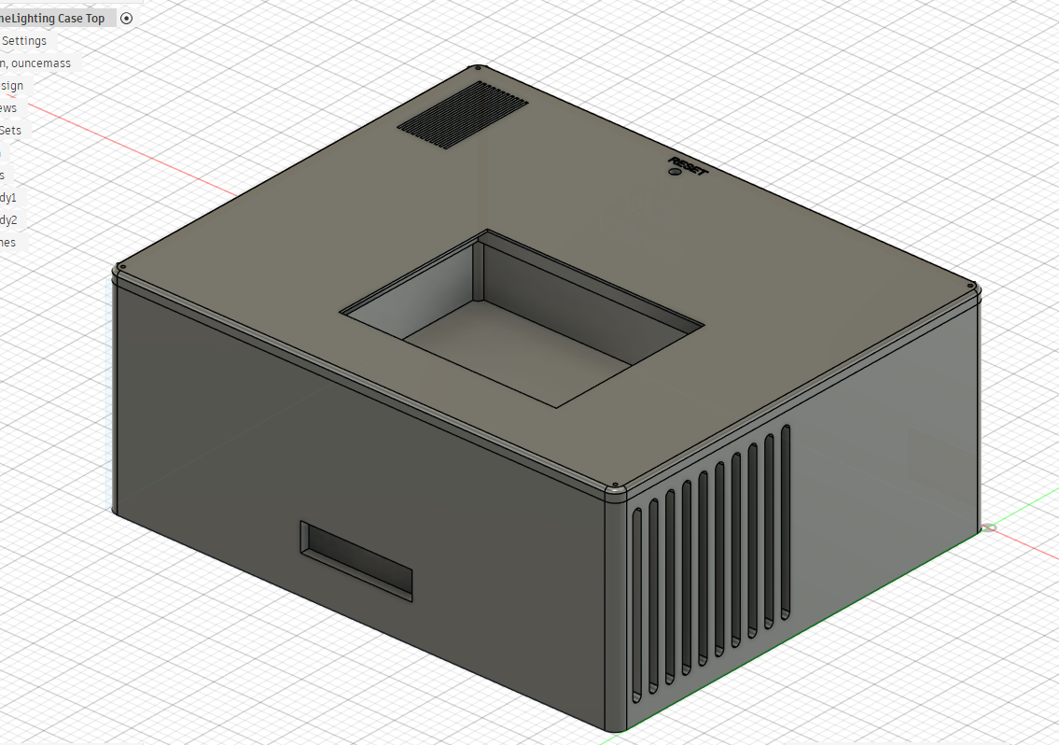
Physical Controls Jack Holdridge
Subsystem Housing
3D model complete
3D print failed due to machine issue, planned to restart print tonight.

Slide 9
Android Application and Camera Kyle Walcher
Accomplishments since last update 12 hrs of effort | Ongoing progress/problems and plans until the next presentation
Motion Sensor to Camera Logic Code and Circuit Backend and Frontend Battery Percentage Display Remote Lighting Control Logic | Lighting Control Testing and Verification Battery Display Integration

Slide 10
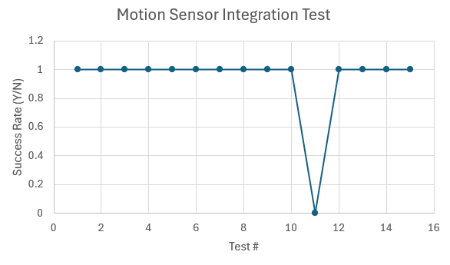
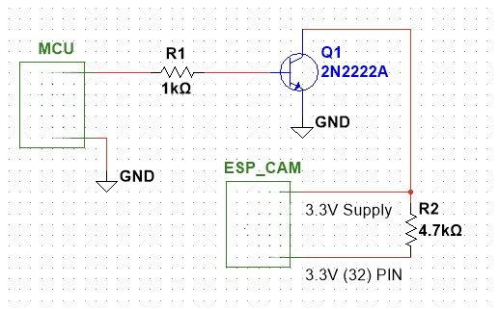
Android Application and Camera Kyle Walcher
Motion Sensor Integration Test Criteria
3.3V -> ESP32 Wakes & Pic
Picture Uploads to Firebase
Application Notification and displays
<15 s
Motion Sensor Integration Test Results
93% Efficiency
1 fail due to connection timeout
Stable WiFi is a must

Slide 11
MCU, Sensors & Database Matthew Greer
Accomplishments Update 17 Hours | Ongoing progress/problems and plans until the next presentation
Implemented UART command parsing for touchscreen → to MCU Restructured lighting logic to support Auto and Manual Override Structured 3-task RTOS architecture (UI/Control,Network) | Integrate database control with mobile app interface Implement software-level integration between MCU and charge controller Begin physical testing of updated motion sensors and collect data of logic timing

Slide 12
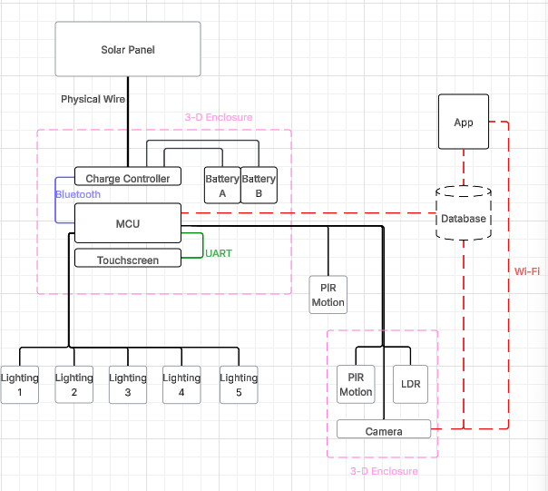
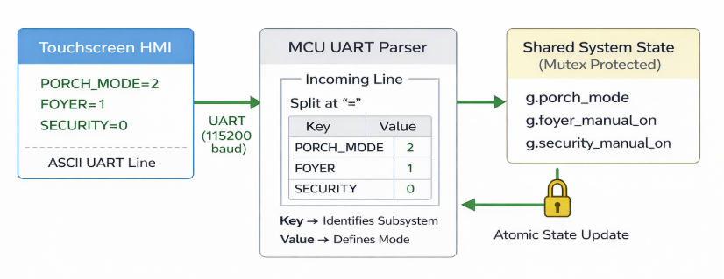

Slide 13
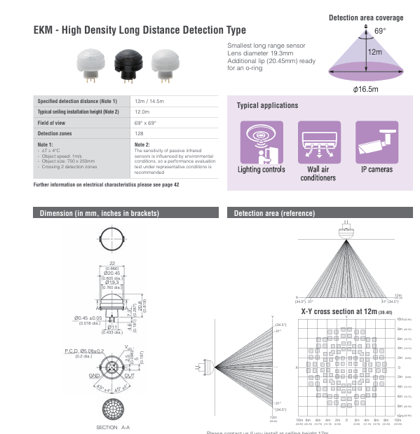
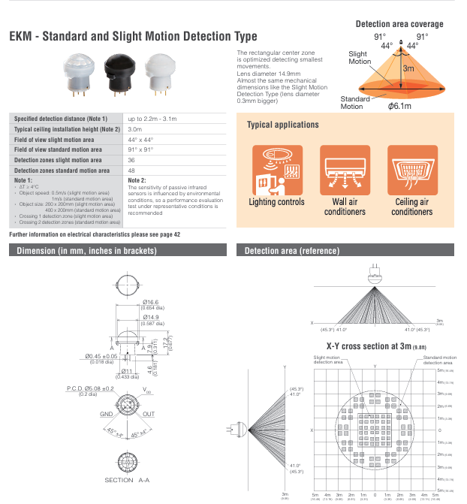

Slide 14
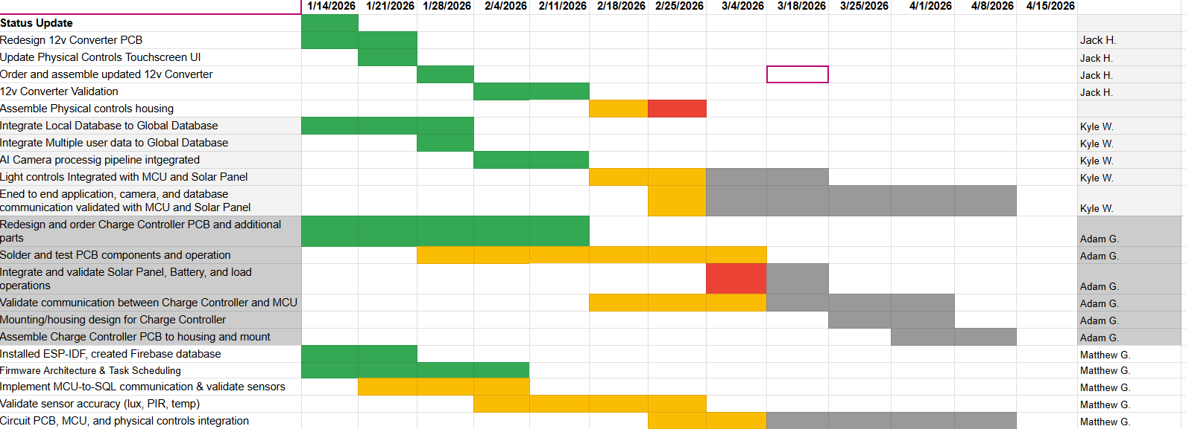
Execution Plan
Notes:
Michelle

Slide 15
System Validation Plan
Name | Requirement | Success Criteria | Methodology | Responsible | Status
Solar Charging | FSR-PWR-1 | Battery charges to 13.6–14.4 V from solar input | Apply solar input and measure battery voltage/current rise | Adam | NC
Battery Powered Operation | FSR-PWR-2 | System operates from 10.8–14.2 V battery rail | Disconnect solar and verify lights, sensors, and MCU operation | Jack | NC
Motion Lighting Response | FSR-FUNC-1 | Lights activate ≤3 s after motion detection | Trigger PIR sensor and measure relay/light response | Matt | NC
Sensor Functionality | FSR-FUNC-2 | PIR, reed, and daylight sensors report correct state | Trigger each sensor and verify MCU detection and response | Matt | NC
Touchscreen Control & Status | FSR-FUNC-3 | Button press toggles relay and updates button color/state | Press HMI buttons and verify relay action + UI update | Jack | NC
Mobile App Control | FSR-FUNC-4 | App command toggles lighting ≤3 s delay | Send command from app and verify relay activation | Kyle | NC
Camera Streaming | FSR-SEC-1 | Live video visible with ≤2 s latency | Open mobile app and verify camera stream delay | Matt | NC
Event Capture & Upload | FSR-SEC-2 | Motion event stored in database with timestamp | Trigger motion and confirm uploaded image/log entry | Matt | NC
System Power Stability | FSR-SYS-1 | 3.3 V and 12 V rails within ±5% during operation | Run full system and measure rails with multimeter | Jack | NC
Multi-Subsystem Operation | FSR-SYS-2 | Lights, sensors, camera, and app operate together | Run integrated system 30 min without reset | Team | NC

Slide 16
Solar Home Lighting 3:
Thank you for listening!
Questions?
Jack Holdridge
Kyle Walcher
Matthew Greer
Adam Garcia
TA: Guanhua Tao
Sponsor: Won Jang

